Slide 1
Welcome to the OOI Teaching with Data Workshop
Janice McDonnell, Kristin Hunter Thomson & Sage Lichtenwalner, Rutgers University
Catherine Halversen, Lawrence Hall of Science
Erin Bardar, EDC

Slide 2
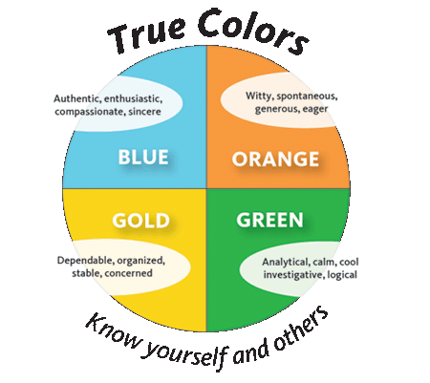
Icebreaker

Slide 3
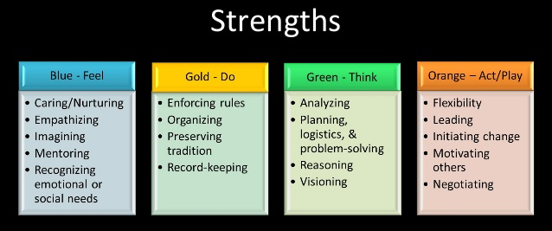
Ice Breaker

Slide 4
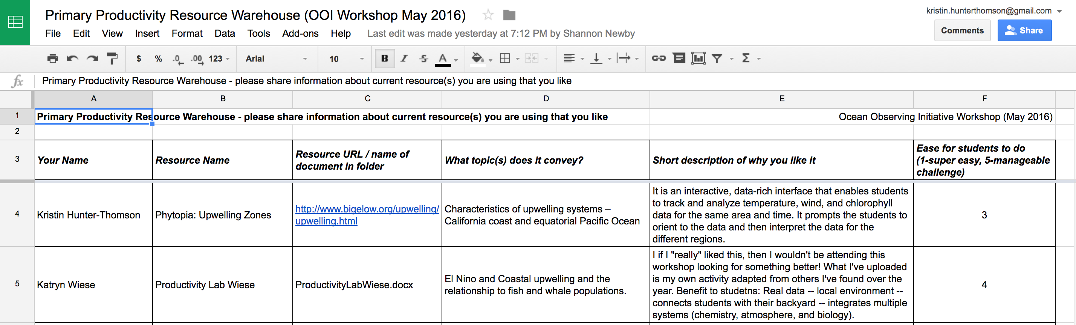
Primary Productivity Resources
https://drive.google.com/drive/folders/0B53yDSDFWmzScHRSQTBtdWhQdUk
Notes:
Friday 8:30pm
We just talked through many great ways we are all teaching primary productivity at the moment in our courses, let’s take a moment to comment to one another about some of the great resources that we have found over the years in our teaching. Some of you shared some already in the google sheet and folder. Those that did, is there something that you would like to say about what you posted? Those that didn’t get a chance to post things yet is there something that you are using that you think others would like to know about?

Slide 5
What we expect from this workshop…
Catherine Halversen

Slide 6
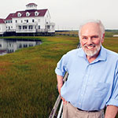
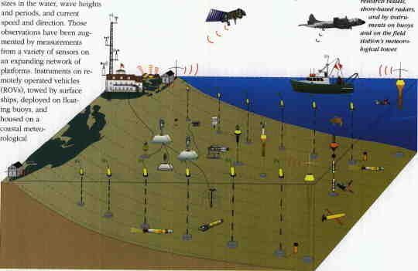
Goals for the Workshop: Background
Long history of interest in teaching with data

Slide 7
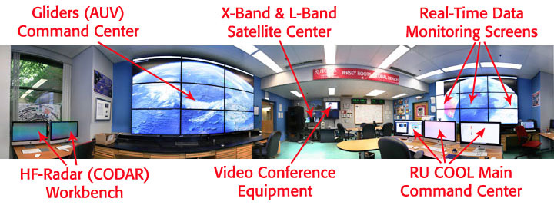
Coastal Ocean Observation Lab

Slide 8
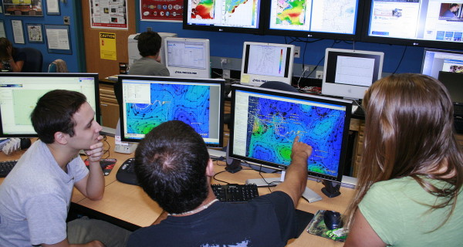
Coastal Ocean Observation Lab

Slide 9
Workshop Objectives
Crosswalk OOI Science themes presented in popular introductory textbooks used in oceanography courses. Compare themes and concepts in the OOI scientific themes document and popular published textbooks to triangulate where OOI data investigations/activities can be woven into existing courses.
Develop sample activities using OOI data/data viz tools and vet them with undergraduate professors.
Brainstorm how best to build a community of practice. Build long-term working relationships and collaborations on data investigation development.
Notes:
hands-on workshop focused on developing effective teaching with data practices using OOI

Slide 10
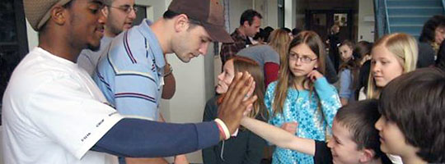
Agenda at a Glance
Friday: Get to know each other; What the nature of our partnership?
Saturday: Review of activities & modify
Sunday: Implementation planning

Slide 11

Thank you! We are excited and grateful for your partnership

